Slide 1

Loops
TUIT
C++ Programming, Fall 2016
Lab #5
(II - part)

Slide 2
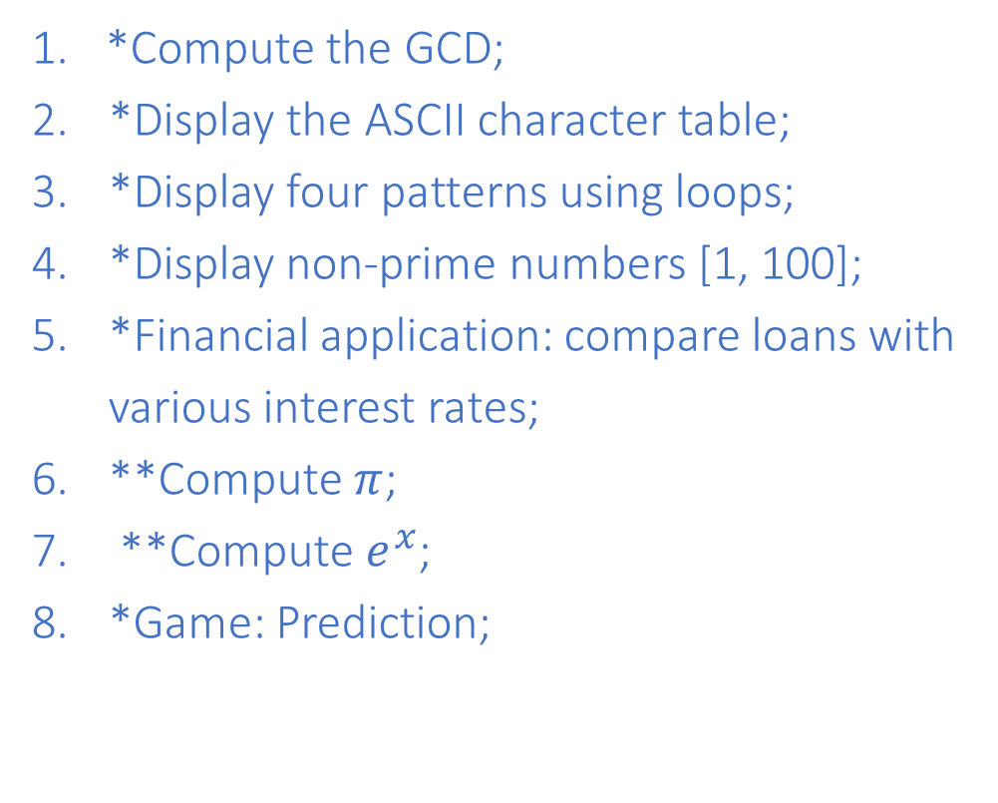
Read the lecture notes doing following tasks:
TUIT
Practice (II - part)
*Compute the GCD;
*Display the ASCII character table;
*Display four patterns using loops;
*Display non-prime numbers [1, 100];
*Financial application: compare loans with various interest rates;
**Compute $π$;
**Compute $e^{x}$;
*Game: Prediction;
*Fibonacci Series;
***Game: scissor, rock, paper;
*Summation;
*Palindrome number;
**Occurrence of max numbers;
*Simulation: clock countdown;
*Math: combinations;
* Computer architecture: bit-level operations.

Slide 3


TUIT
1. *Compute the GCD
Another solution for example to find the greatest common divisor (GCD) of two integers n1 and n2 is as follows: First find d to be the minimum of n1 and n2, then check whether d, d-1, d-2, …,2, or 1 is a divisor for both n1 and n2 in the order. The first such common divisor is the greatest common divisor for n1 and n2. write a program that prompts the user to enter two positive integers and displays the GCD.
Here is a sample run:
Enter two positive numbers: 36 48 GCD(36, 48) = 12

Slide 4
TUIT
2. *Display the ASCII character table
Write a program that prints all the uppercase characters of the ASCII character table. Display 5 characters per line. Characters are separated by exactly one space.
Here is the sample run:
A B C D E F G H I J K L M N O P Q R S T U V W X Y Z

Slide 5
TUIT
3. * *Display four patterns using loops
Use nested loops that display the following patterns in four separate programs:
Pattern A
123456
1 6
1 6
1 6
1 6
123456
Pattern B
1
1 2 3
1 2 3 4 5
1 2 3 4 5 6 7
1 2 3 4 5 6 7 8 9
Pattern C
3
3 3
3 3 3
3 3
3
Pattern D
1
1 2
1 2 3
1 2 3 4
1 2 3 4 5
1 2 3 4 5 6

Slide 6
TUIT
4. *Display non-prime numbers [1, 100]
Display all the non-prime numbers between 1 and 100. Display five non-prime numbers per line. Numbers are separated by exactly one space.
Here is a sample run:
1 4 6 8 9 10 12 14 15 16 18 20 21 22 24 25 26 27 28 30 32 33 34 35 36 38 39 40 42 44 45 46 48 49 50 51 52 54 55 56 57 58 60 62 63 64 65 66 68 69 70 72 74 75 76 77 78 80 81 82 84 85 86 87 88 90 91 92 93 94 95 96 98 99 100

Slide 7
5. *Financial application: compare loans with various interest rates
TUIT
Write a program that lets the user enter the loan amount and loan period in number of years and displays the monthly and total payments for each interest rate starting from 5% to 8%, with an increment of 1/8.
Here is the sample run:
Loan Amount: 10000 Number of Years: 5 Interest Rate Monthly Payment Total Payment 5.000% 188.71 11322.74 5.125% 189.28 11357.13 5.250% 189.85 11391.59 … 7.875% 202.17 12129.97 8.000% 202.76 12165.83

Slide 8


TUIT
6. **Compute $π$
You can approximate $π$ by using the following series:
$$π=\sqrt{6×(1+\frac{1}{4}+\frac{1}{9}+\frac{1}{16}+…+\frac{1}{n^{2}})}$$
Here is a sample run:
Enter an integer n: 10000 Approximately PI is equal 3.1415

Slide 9
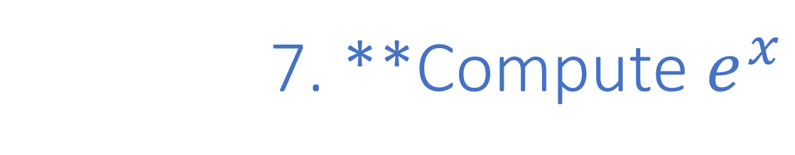
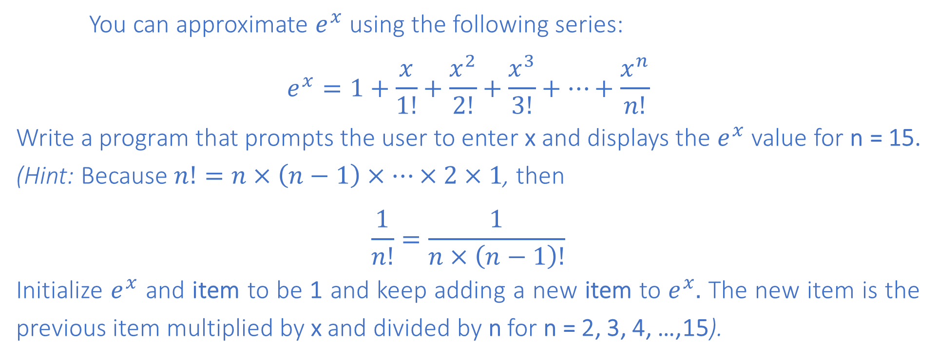
TUIT
7. **Compute $e^{x}$
You can approximate $e^{x}$ using the following series:
$$e^{x}=1+\frac{x}{1!}+\frac{x^{2}}{2!}+\frac{x^{3}}{3!}+…+\frac{x^{n}}{n!}$$
Write a program that prompts the user to enter x and displays the $e^{x}$ value for n = 15. (Hint: Because $n!=n×\left(n−1\right)×…×2×1$, then
$$\frac{1}{n!}=\frac{1}{n×\left(n−1\right)!}$$
Initialize $e^{x}$ and item to be 1 and keep adding a new item to $e^{x}.$ The new item is the previous item multiplied by x and divided by n for n = 2, 3, 4, …,15).
Here is a sample run:
Enter an integer x: 5 Approximately e^x is equal 148.447

Slide 10
TUIT
8. * *Game: Prediction
Generate a random three-digit number. The three digits in the number must be distinct. (Hint: Generate the first digit. Use a loop to repeatedly generate the second and third digits until they are different from other digits.)
Here is a sample run:
The computer generate 127 three-digit number!

Slide 11
TUIT
9. *Fibonacci Series
The Fibonacci series is a series that begins with 0 and 1 and has the property that each succeeding term is the sum of the two preceding terms. For example, the third Fibonacci number is 1 which is sum of 0 and 1. The next is 2, which is a sum of 1 + 1. Write a program that displays the first ten numbers in a Fibonacci series.
Here is a sample run:
First ten Fibonacci numbers: 0 1 1 2 3 5 8 13 21 34

Slide 12
TUIT
10. ***Game: scissor, rock, paper
Revise lab #3 (II - part) second exercise to let the user continuously play ten games. The program must display the number of times a user wins, the computer wins and the number of draws.
Here is a sample run:
Scissor (0), rock (1), paper (2): 1 The computer is scissor, You are rock. You won Scissor (0), rock (1), paper (2): 2 The computer is paper, You are paper too. It is a draw … Scissor (0), rock (1), paper (2): 1 The computer is paper, You are rock. Computer won You won 5 times, Computer won 3 times, and Draw 2 times

Slide 13
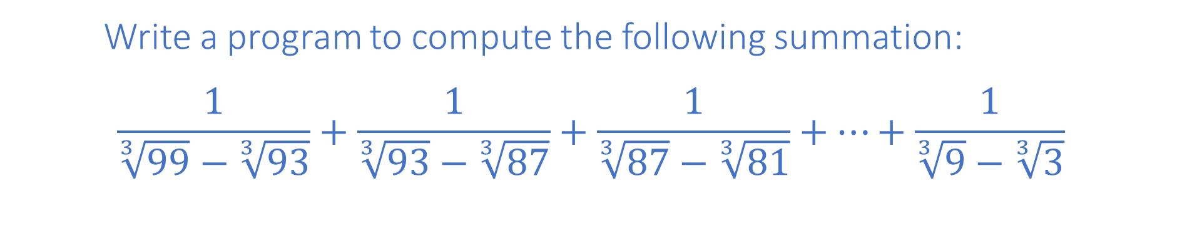
TUIT
11. *Summation
Write a program to compute the following summation:
$$\frac{1}{\sqrt[3]{99}−\sqrt[3]{93}}+\frac{1}{\sqrt[3]{93}−\sqrt[3]{87}}+\frac{1}{\sqrt[3]{87}−\sqrt[3]{81}}+…+\frac{1}{\sqrt[3]{9}−\sqrt[3]{3}}$$

Slide 14
TUIT
12. *Palindrome number
Write a program that prompts the user to enter an integer and uses loops to simplify lab #3 (II - part) 16 exercise.

Slide 15
TUIT
13. **Occurrence of max numbers
Write a program that reads integers, finds the largest of them, and counts its occurrences. Assume that the input ends with number 0. Suppose that you entered 3 5 2 5 5 5 0; the program finds that the largest is 5 and the occurrence count for 5 is 4.
(Hint: Maintain two variables, max and count. max stores the current max number, and count stores its occurrences. Initially, assign the first number to max and 1 to count. Compare each subsequent number with max. If the number is greater than max, assign it to max and reset count to 1. if the number is equal to max, increment count by 1.)
Here is a sample run:
Enter numbers: 3 5 2 5 5 5 0 The largest number is 5 The occurrence count of the largest number is 4

Slide 16
TUIT
14. *Simulation: clock countdown
Write a program that prompts the user to enter the number of seconds, displays a message at every second, and terminates when the time expires. Here is sample run:
Here is a sample run:
Enter the number of seconds: 3 2 seconds remaining 1 second remaining Stopped

Slide 17
TUIT
15. *Math: combinations
Write a program that displays all possible combinations for picking two numbers from integers 1 to 7. Also, display the total number of all combinations.
Here is a sample run:
1 2 1 3 … … The total number of all combinations is 21

Slide 18
TUIT
16. * Computer architecture: bit-level operations
A short value is stored in 16 bits. Write a program that prompts the user to enter a short integer and displays the 16 bits for integer
Here are a sample runs:
Enter an integer: 5 The bits are 0000000000000101
Enter an integer: -5 The bits are 1111111111111011

